Slide 1
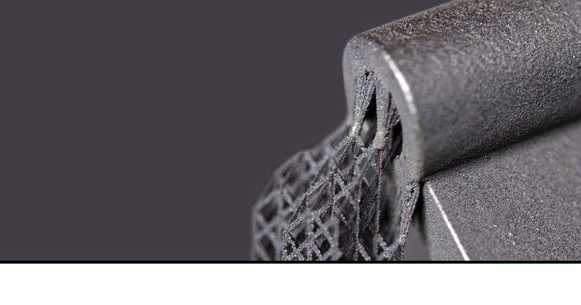
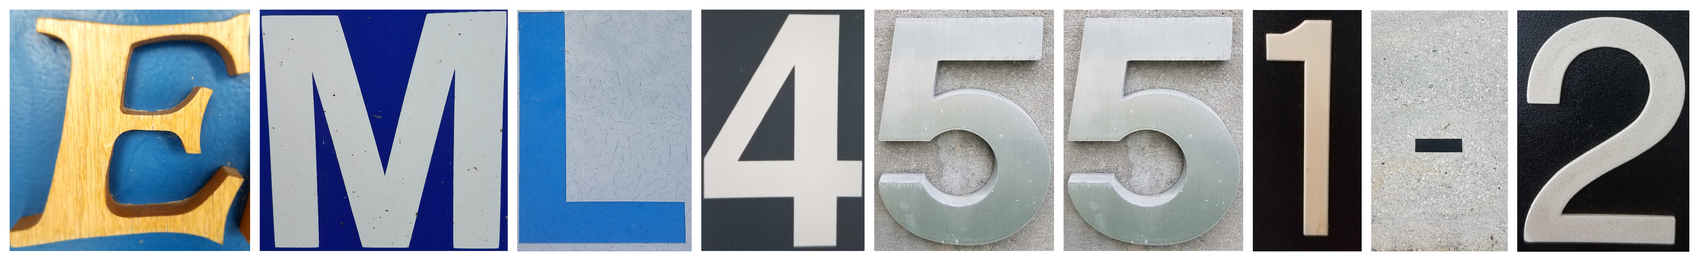
Team 501: Powder Recovery for Metal Additive Manufacturing
Arlan Ohrt
Kevin Richter
Vincent Giannetti
Noah Tipton
Joshua Dorfman
March 10th, 2020

Slide 2






Team Introductions
Joshua Dorfman
Noah Tipton
Arlan Ohrt
Vincent Giannetti
Kevin Richter
Field
Engineer
Design
Engineer
Project/Systems Engineer
Manufacturing
Engineer
Field
Engineer

Slide 3

Sponsor – Air Force Research Labs (AFRL)
AFRL/RWMW – Ordnance Division, Damage Mechanisms Branch (Eglin Air Force Base)
  A global leader in advancing weapons science and technology
Specific Contact - Dr. Philip Flater
  Lead for the metal additive manufacturing lab at AFRL/RWMW
Joshua Dorfman

Slide 4
Project Description
The objective of this project is to design a device which increases the amount of recovered steel powder in a metal additive manufacturing process. This device should be compatible with existing hardware and processes while ensuring the safety of the operators.
Joshua Dorfman

Slide 5
Project Key Goals and Customer Needs
The objective of this project is to design a device which increases the amount of recovered steel powder in a metal additive manufacturing process. This device should be compatible with existing hardware and processes while ensuring the safety of the operators.
Increase amount of recovered steel powder
Be compatible with existing hardware and processes
Ensure operators safety
Joshua Dorfman

Slide 6

Remove
The Scope of the Project
Recycle
Recover
Joshua Dorfman

Slide 7
The Scope of the Project
Remove
Sponsor
Design Team
Recycle
Recover
Joshua Dorfman

Slide 8
The Scope of the Project
Remove
Sponsor
Design Team
Recycle
Recover
Joshua Dorfman

Slide 9
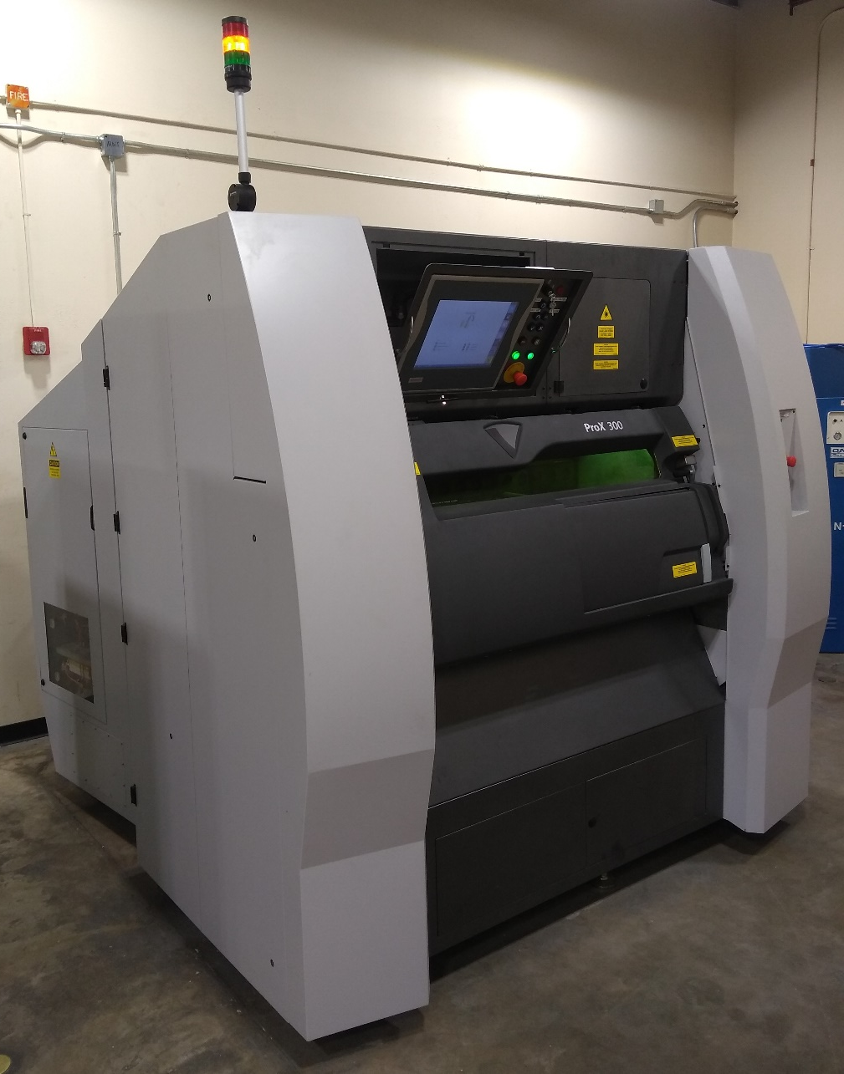
Project Background – Metal Additive Manufacturing
Laser Powder Bed Fusion (LPBF):
Powder Distributed in an Even Layer
Laser Traces Layer Path to “Fuse” Material Together
This process results in a large amount of “unfused” powder. This powder should be recycled.
AFRL’s operating 3D printer is the 3D Systems ProX 300
Joshua Dorfman

Slide 10
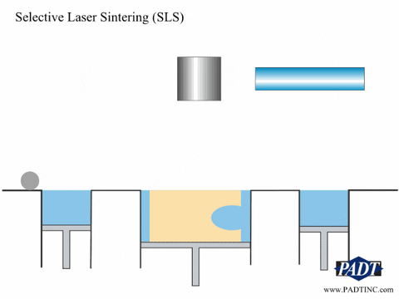
Project Background – Metal Additive Manufacturing
Laser Powder Bed Fusion (LPBF):
Powder Distributed in an Even Layer
Laser Traces Layer Path to “Fuse” Material Together
This process results in a large amount of “unfused” powder. This powder should be recycled.
Joshua Dorfman

Slide 11
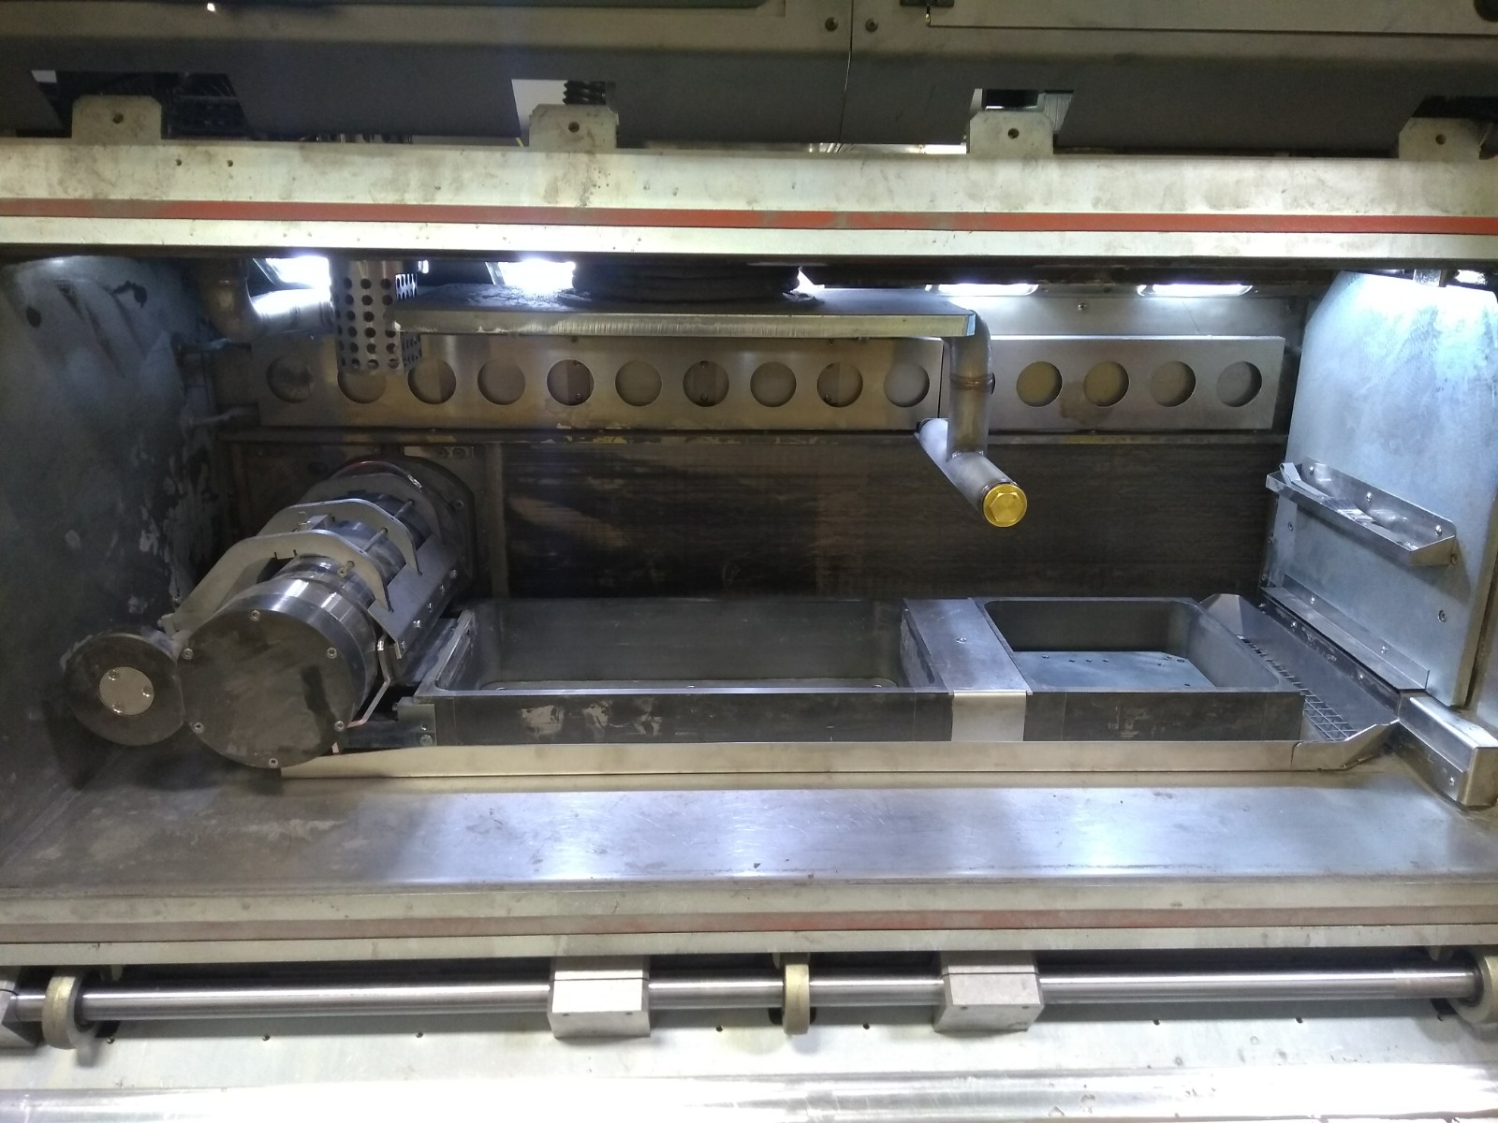
Project Background – Metal Additive Manufacturing
Powder Supply
Build Plate
Roller
Overflow
Joshua Dorfman

Slide 12
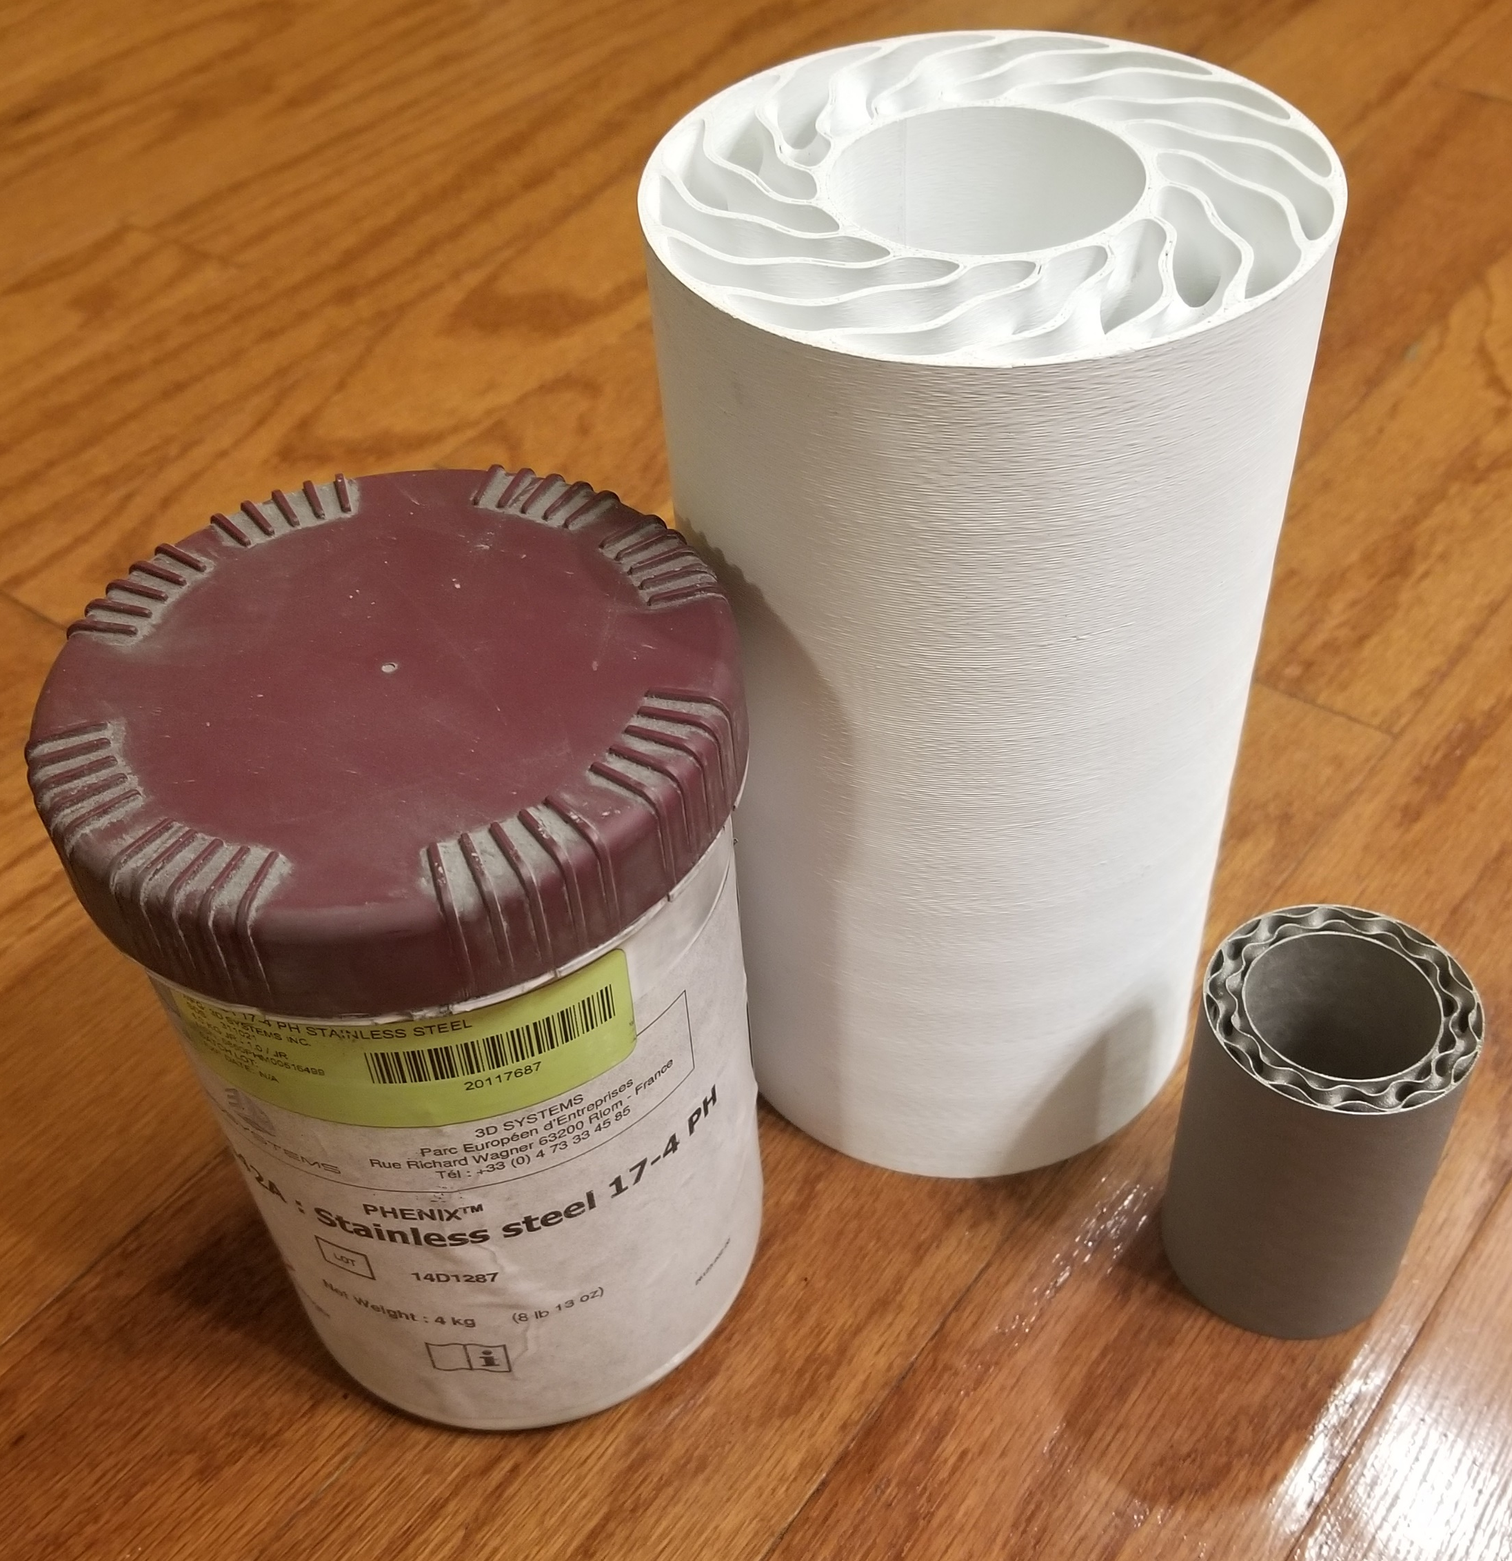
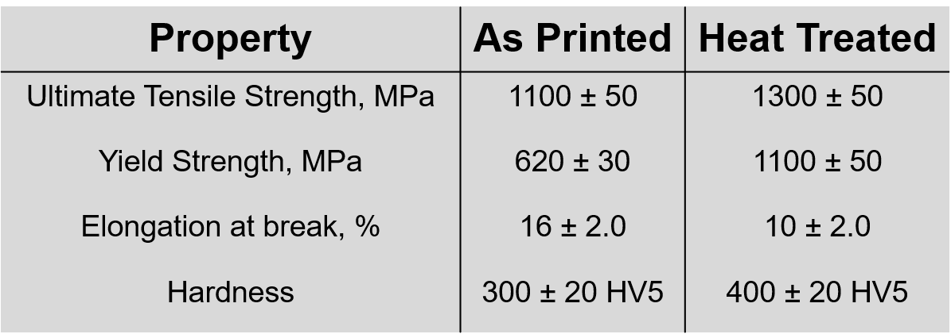
Project Background – The Metal Used
17– 4PH Stainless Steel: 17% Chromium, 4% Nickel, Precipitation Hardening
General Info:
Purchasable from 3D Systems
Particle Size: 10 – 15 μm (Paper thickness is ~ 100 μm)
Martensitic Steel (Magnetic)
Joshua Dorfman

Slide 13

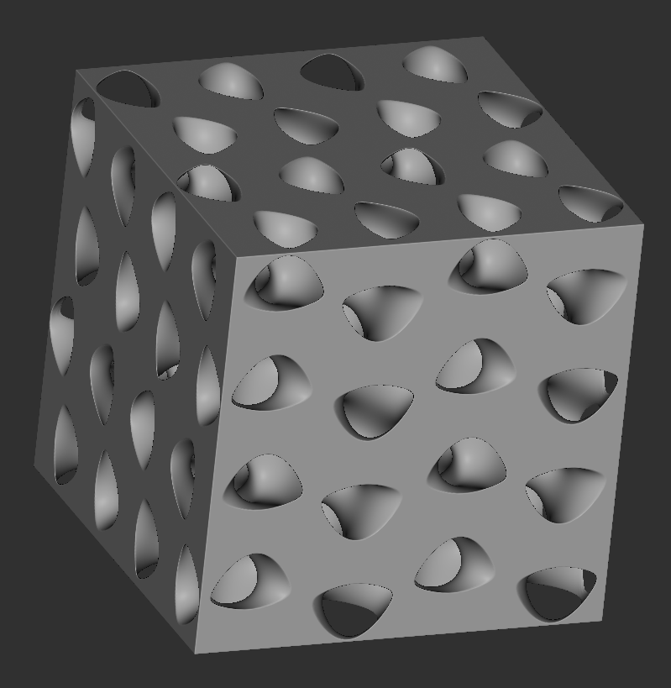
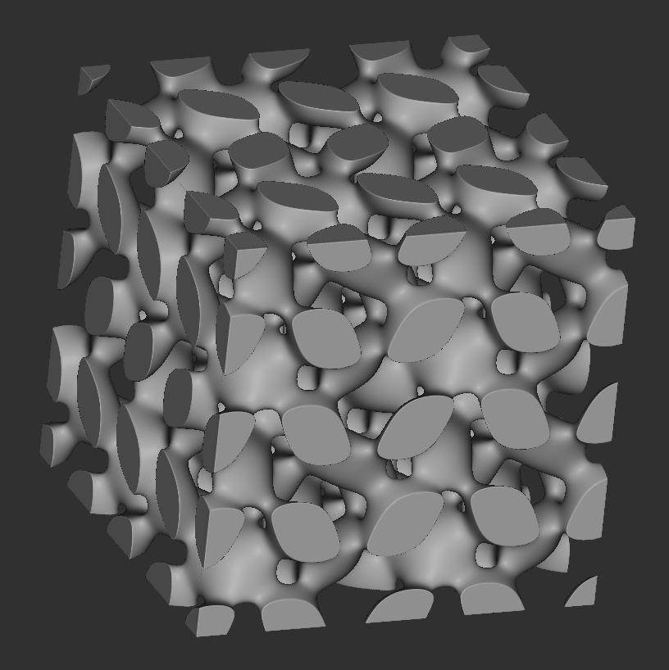
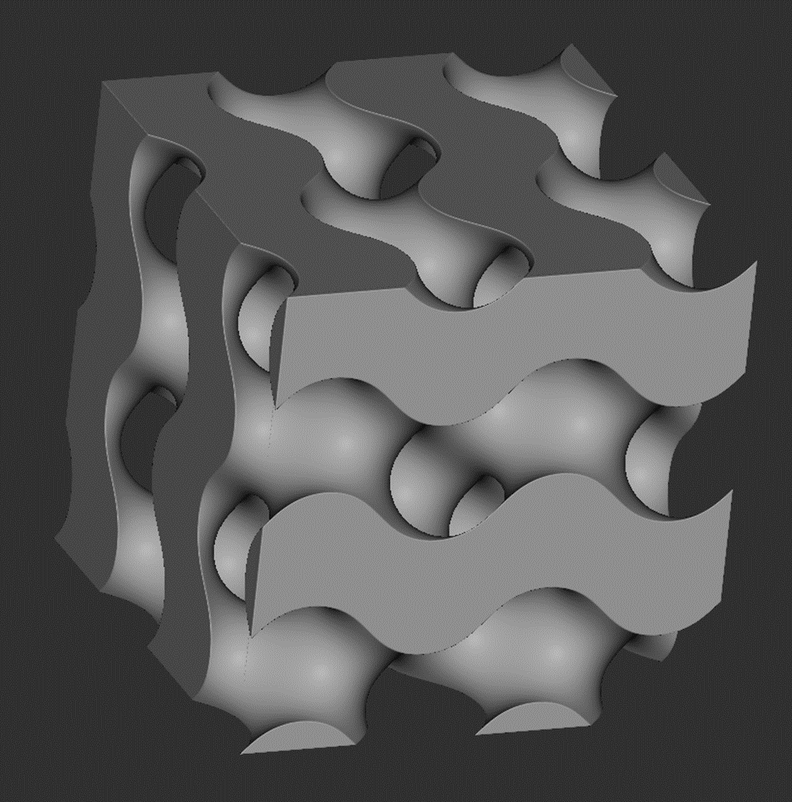
Project Background – The Metal Used
17– 4PH Stainless Steel: 17% Chromium, 4% Nickel, Precipitation Hardening
General Info:
Purchasable from 3D Systems
Particle Size: 10 – 15 μm (Paper thickness is ~ 100 μm)
Martensitic Steel (Magnetic)
Joshua Dorfman

Slide 14
Powder Recovery Stages
Noah Tipton

Slide 15
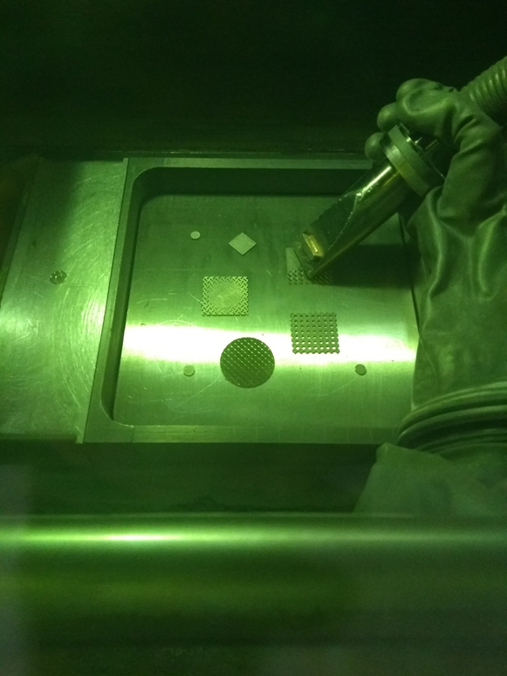
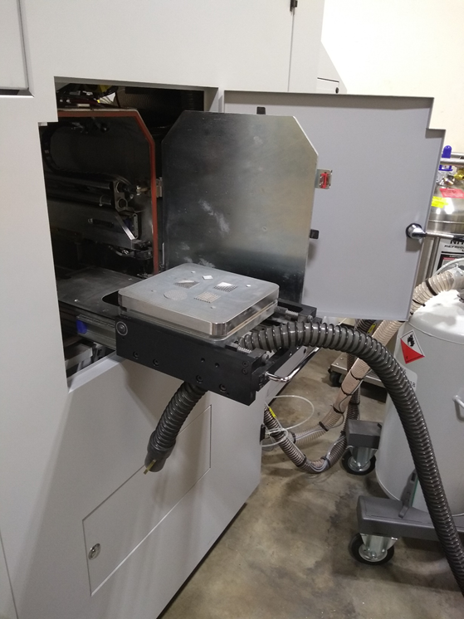
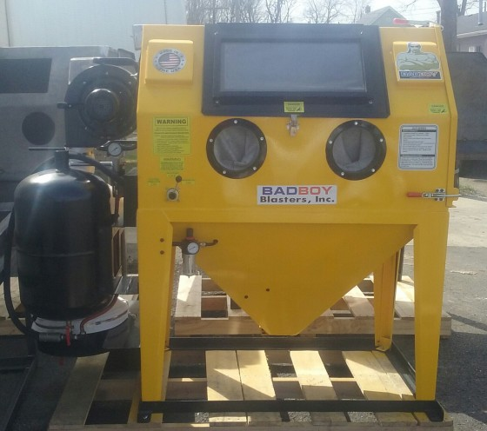
Project Background – Powder Recovery Stages
“Built In Stage”
“Wet Vac Stage”
“Air Powered Stage”
Noah Tipton

Slide 16
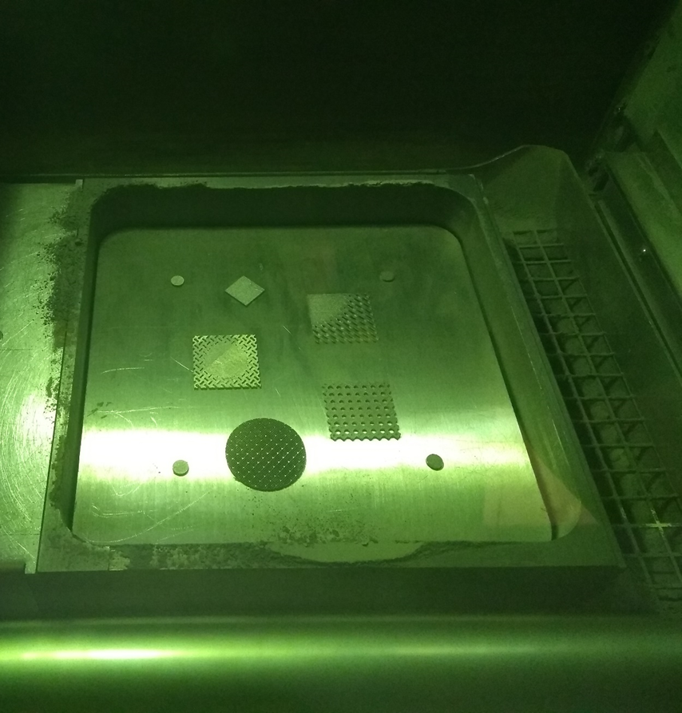
Project Background – Powder Recovery Stages
Stage 1 – “Built In Stage”
Built in recovery system
  Vacuum
  Overflow Reservoir
Operation
  Sealed chamber
  Glove to operate vacuum
Substantial Powder Recovery
Noah Tipton

Slide 17
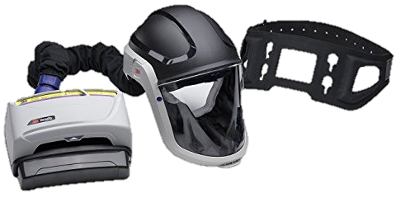
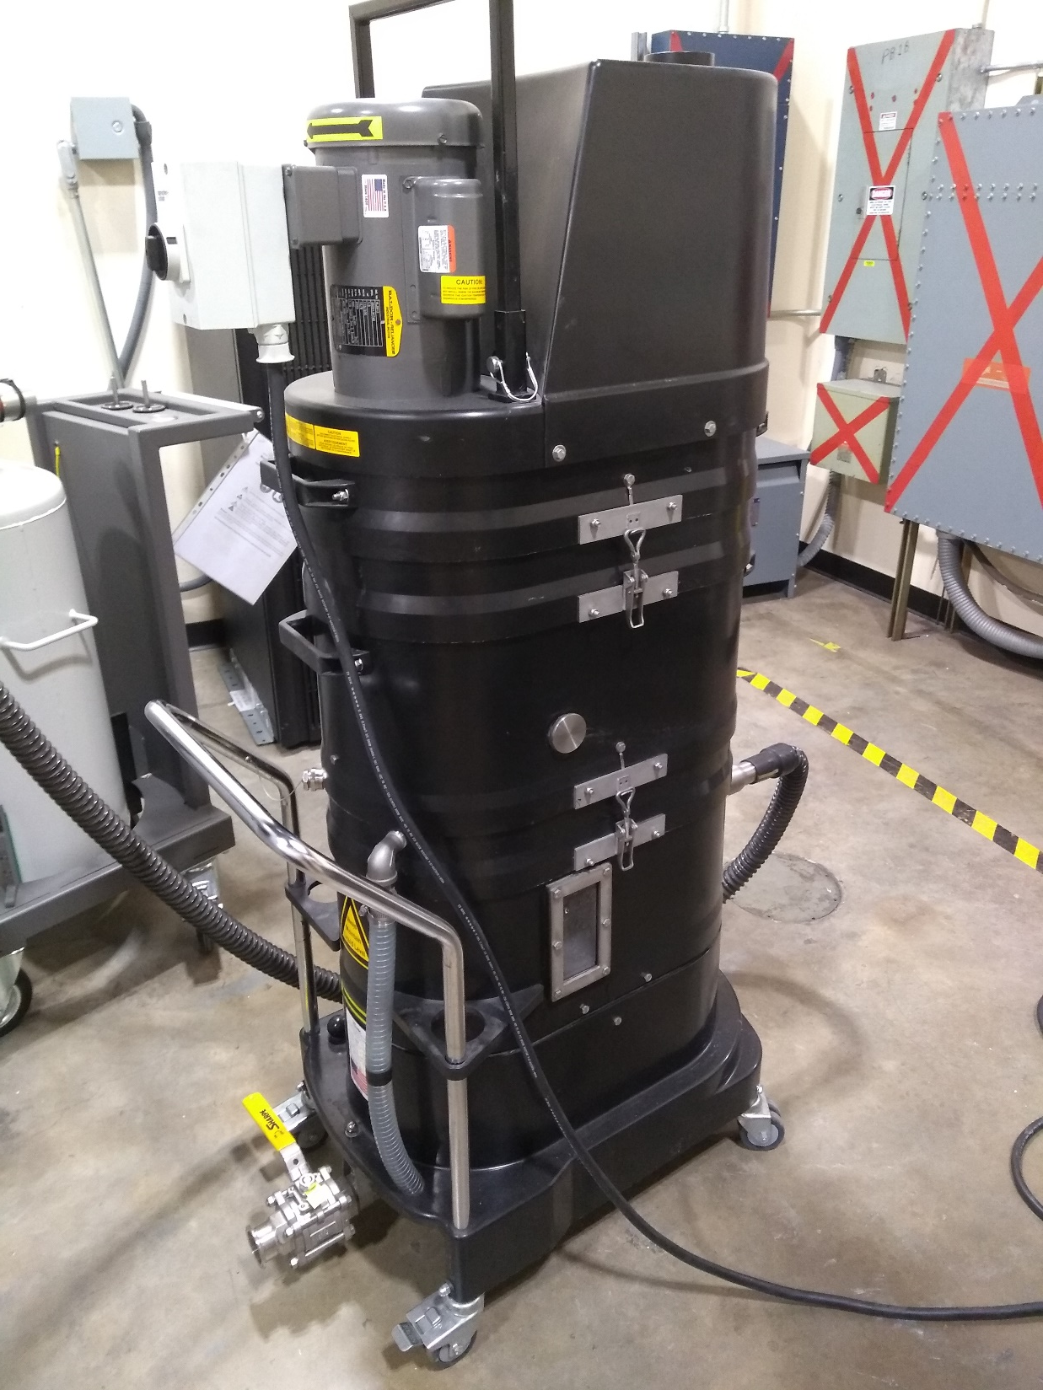
Project Background – Powder Recovery Stages
Stage 2 – “Wet Vac Stage”
Removing the part
  Pass the build plate out
Operation
  Use powered air purifying respirator (PAPR)
  Open door and remove part
  Use Ruwac NA35 Immersion Vacuum
No Powder Recovery
Noah Tipton

Slide 18
Project Background – Powder Recovery Stages
Stage 3 – “Air Powered Stage”
Sandblasting cabinet
Operation
  Place part inside the enclosure
  Use compressed air to remove residual powder
No Powder Recovery
Noah Tipton

Slide 19
“Our System”
Substantial Powder Recovery
Project Background – Powder Recovery Stages
Substantial Powder Recovery
No Powder Recovery
No Powder Recovery
“Built In Stage”
“Wet Vac Stage”
“Air Powered Stage”
Noah Tipton

Slide 20
Project Background – Powder Recovery Stages
“Our System”
Substantial Powder Recovery
Substantial Powder Recovery
No Powder Recovery
No Powder Recovery
“Built In Stage”
“Wet Vac Stage”
“Air Powered Stage”
Noah Tipton

Slide 21
Functional Decomposition with Targets and Metrics
Recover Powder
Manage Powder
Support the Part
Inhibit Powder
Separates powder from the part
Transports powder
to a container
Hold the part
in the area
Isolate the powder
from user
Prevents powder contamination
Mass
Mass
1) Volume
2) Force
Up to Eglin AFB safety standards
Particle Size
Metric
Greater than 0 grams of separated powder in container
1) 250 x 250 x 300 mm
2) 356 N
Pass Bioenvironmental Engineering Flight (BEF) air test
Passes through 75 μm mesh
Target
Noah Tipton

Slide 22
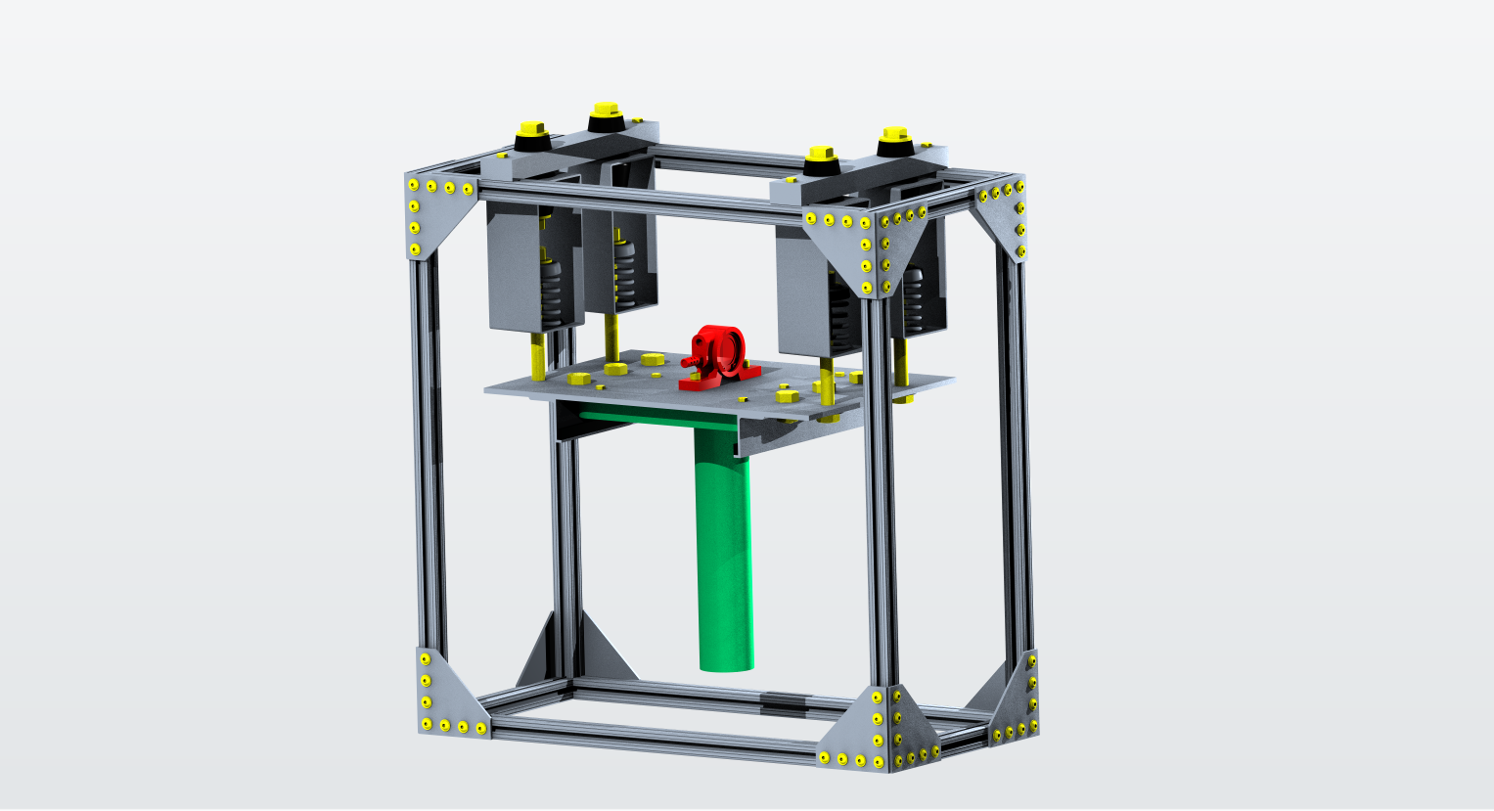
New System
Build Plate and Part
Fasteners
Vibrator
Noah Tipton

Slide 23
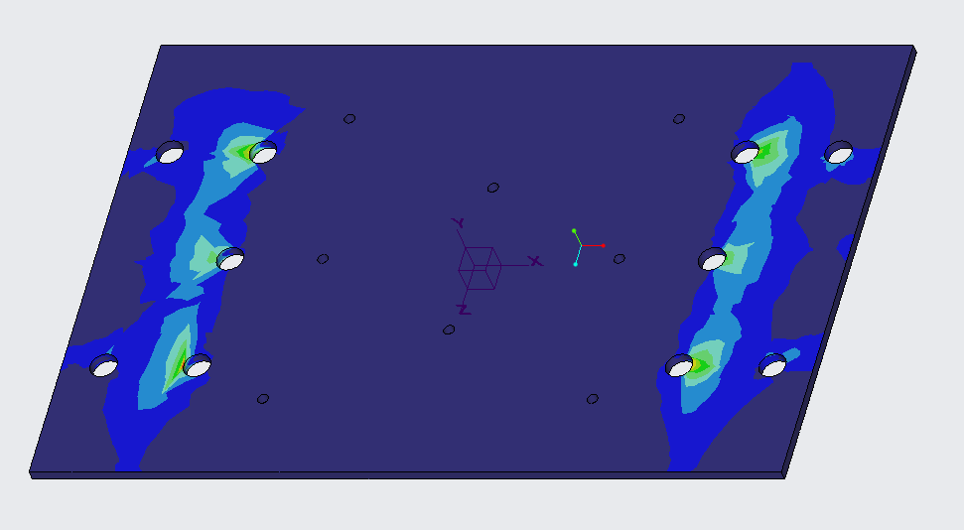
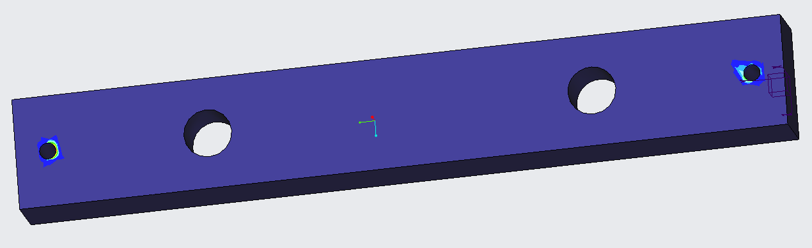
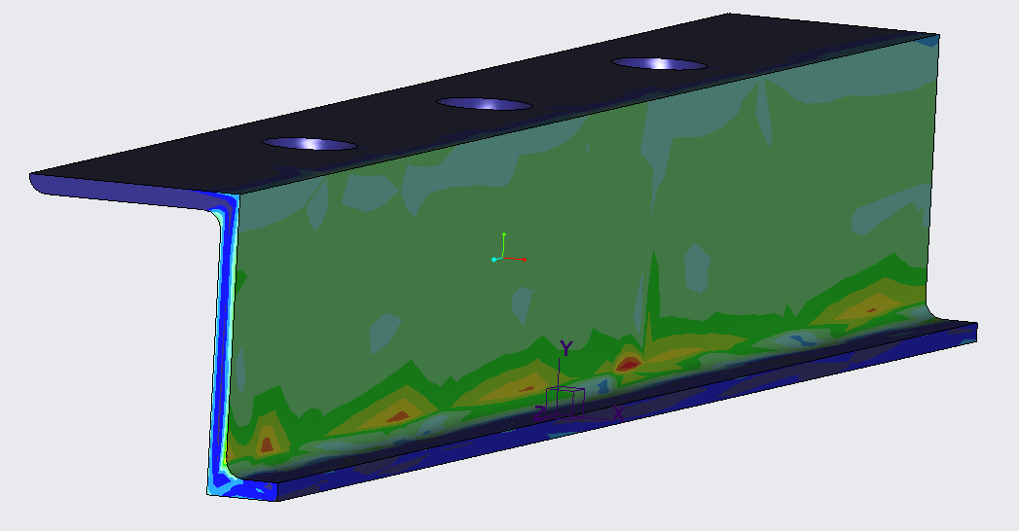
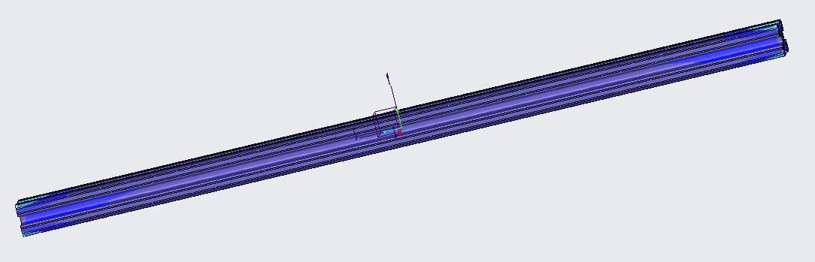
New System – Structural Analysis
σ_{Max}* ≈ 315 psi
σ_{y} ≈ 40,000 psi
τ_{Max} ≈ 157 psi
τ_{Fail} ≈ τ_{Tresca} ≈ 20 ksi
σ_{Max} *≈ 915 psi
σ_{y} ≈ 40,000 psi
σ_{Max}*≈ 300 psi
σ_{y} ≈ 47,000 psi
* CREO Von Mises
Noah Tipton

Slide 24
σ_{Max}* ≈ 315 psi
σ_{y} ≈ 40,000 psi
σ_{Max} *≈ 915 psi
σ_{y} ≈ 40,000 psi
New System – Structural Analysis
τ_{Max} ≈ 157 psi
τ_{Fail} ≈ τ_{Tresca} ≈ 20,000 psi
σ_{Max}*≈ 300 psi
σ_{y} ≈ 47,000 psi
* CREO Von Mises
Noah Tipton
What About Safety?

Slide 25
Build Plate and Part
Fasteners
Vibrator
New System
What About Safety?
Noah Tipton

Slide 26
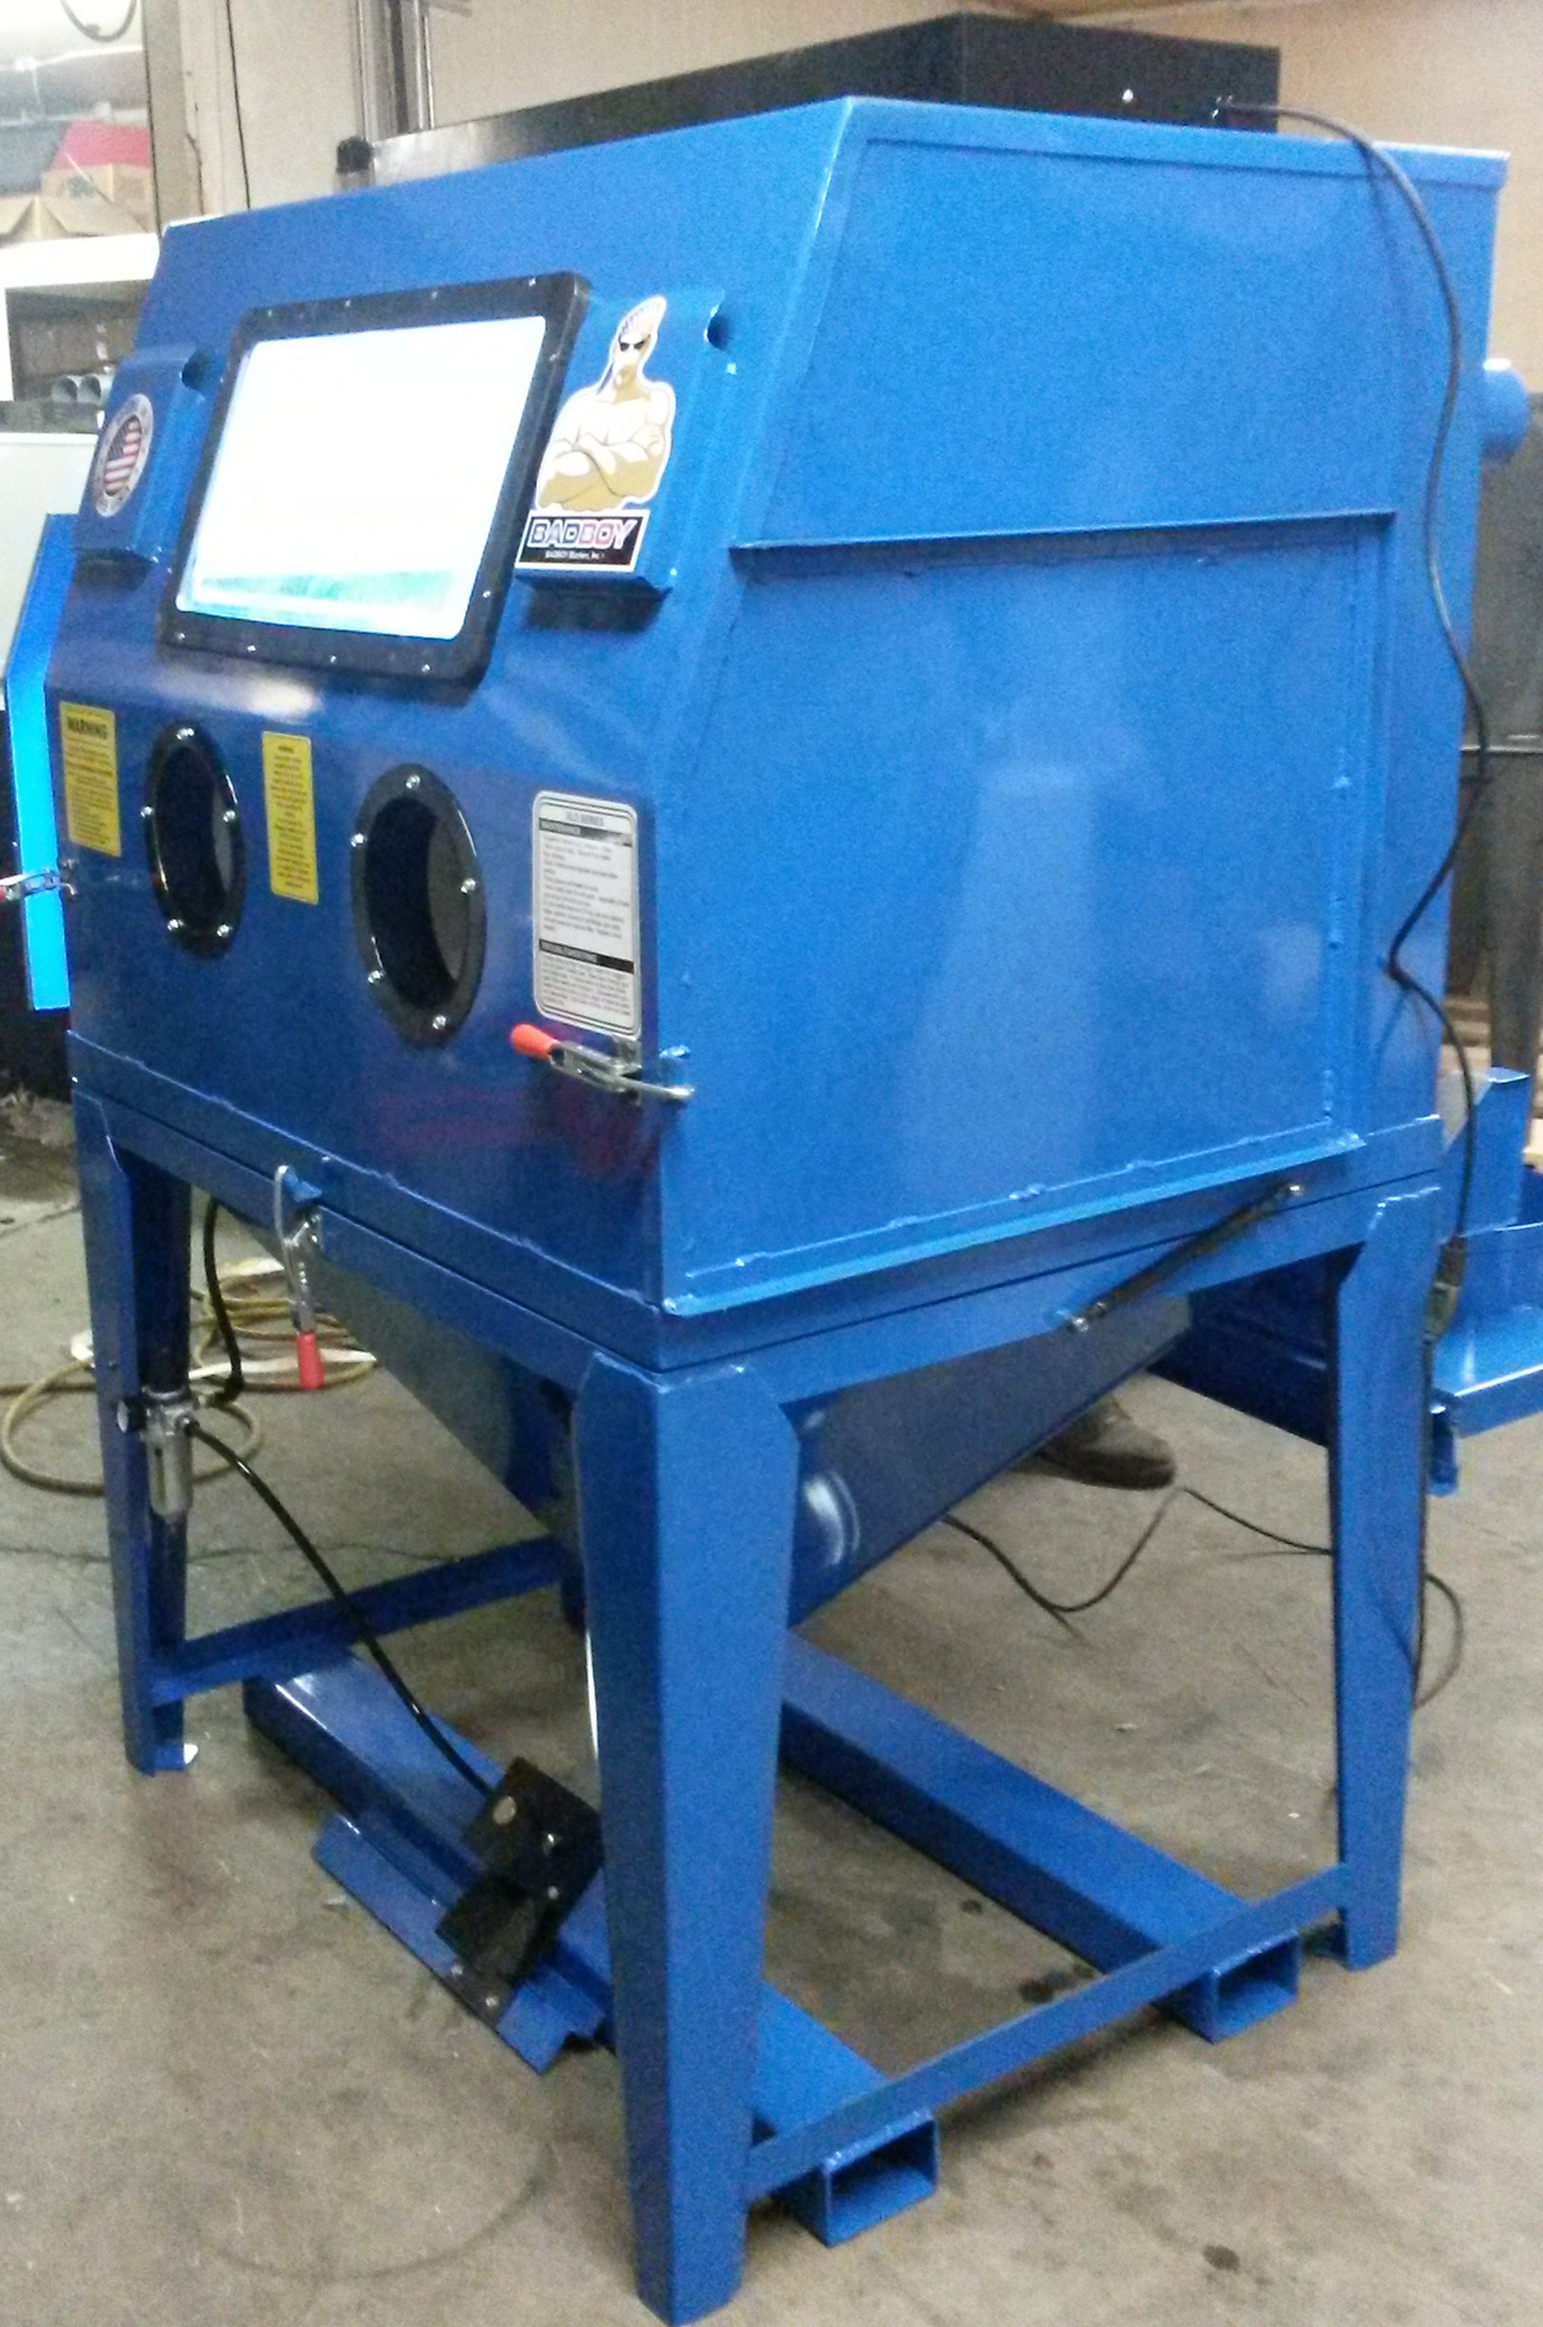
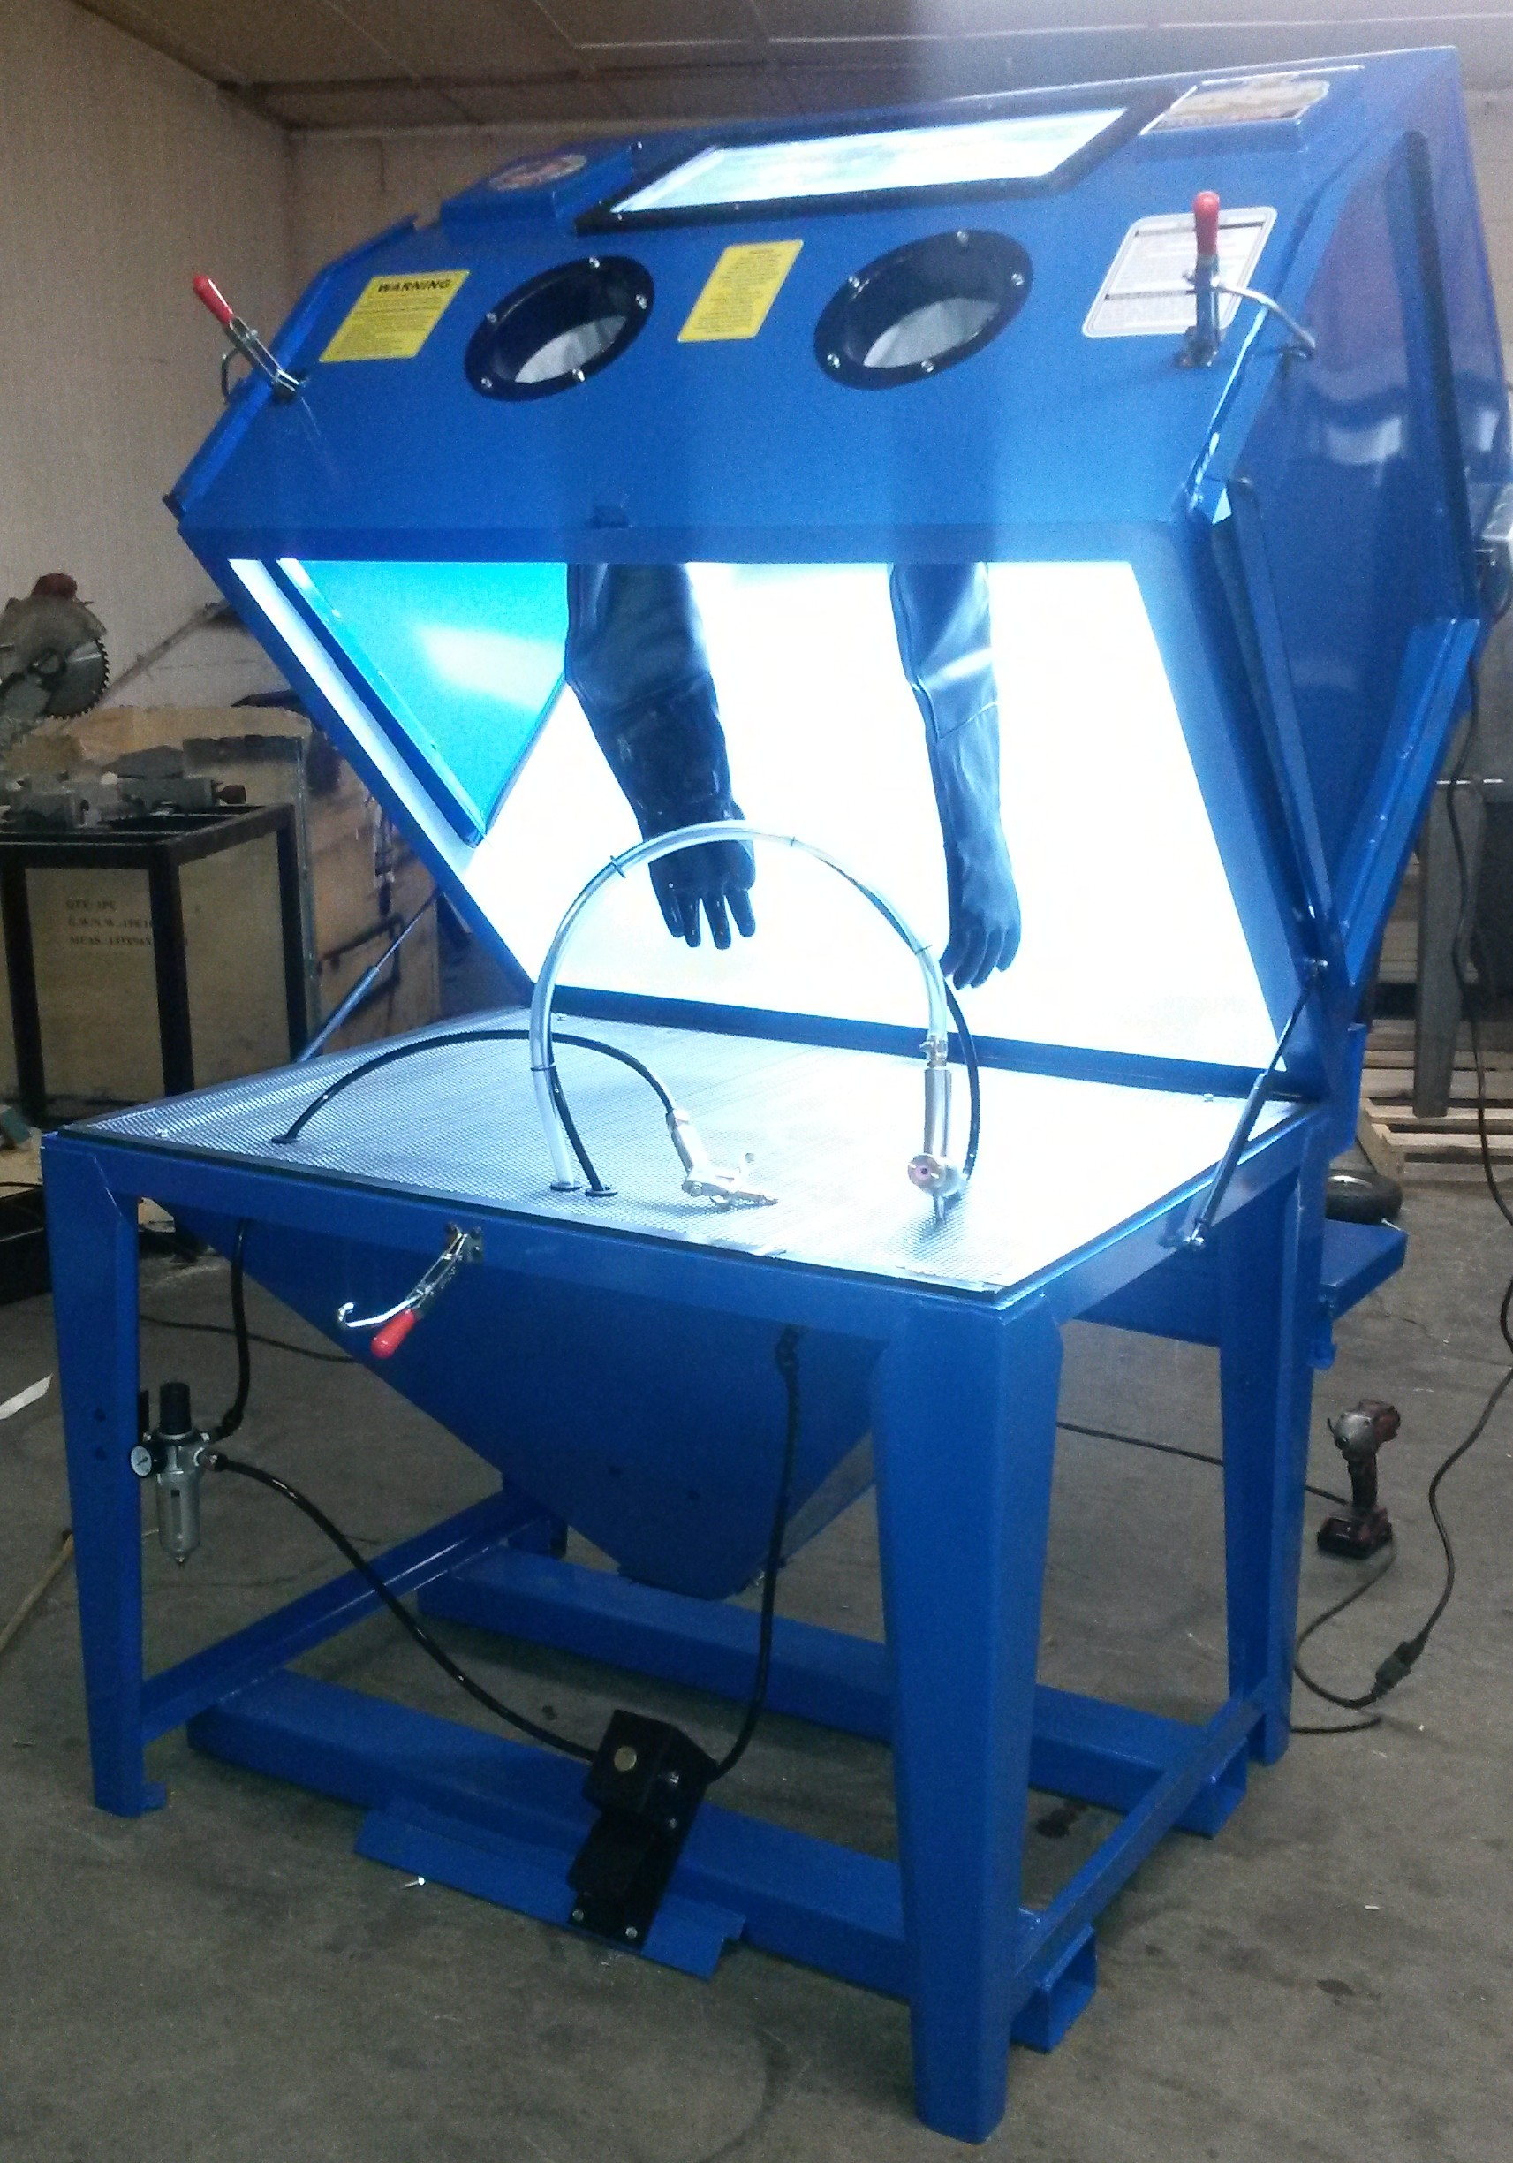
New System
Barrier Needed to Control Powder
BADBOY Blaster
Clamshell Design
Fits Design Well
Industrial Quality
What About Safety?
Noah Tipton

Slide 27
Chosen Barrier
Barrier Needed to Control Powder
BADBOY Blaster
Clamshell Design
Fits Design Well
Industrial Quality
What About Safety?
AFRL is Familiar with BADBOY’s Quality
Noah Tipton

Slide 28
Chosen Barrier
BADBOY Blaster
Clamshell Design
Fits Design Well
Industrial Quality
AFRL is Familiar with BADBOY’s Quality
Noah Tipton

Slide 29
Lessons Learned
Arlan Ohrt

Slide 30
Initial Design Lessons Learned
Top Bar Fasteners
Three Mistakes
Top Bar Fasteners
Vibrator Fasteners
Mounting Plate
Problem
Fasteners were to short
Reason
Supplier CAD was not accurate
Solution
Ordered longer fasteners
Arlan Ohrt

Slide 31
Initial Design Lessons Learned
Top Bar Fasteners
Three Mistakes
Top Bar Fasteners
Vibrator Fasteners
Mounting Plate
Problem
Fasteners were to short
Reason
Supplier CAD was not accurate
Solution
Ordered longer fasteners
Arlan Ohrt

Slide 32
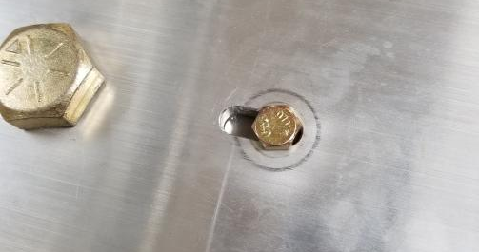
Initial Design Lessons Learned
Vibrator Fasteners
Problem
Fasteners were to short
Reason
Supplier CAD was not accurate
Solution
Ordered longer fasteners
Arlan Ohrt

Slide 33
Initial Design Lessons Learned
Mounting Plate
Problem
Two holes did not line up
Reason
Machining mistake
Solution
Slotted the holes so they could be used
Arlan Ohrt

Slide 34
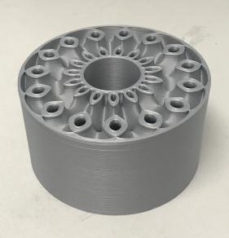
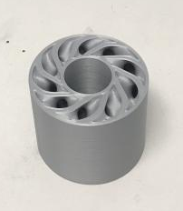
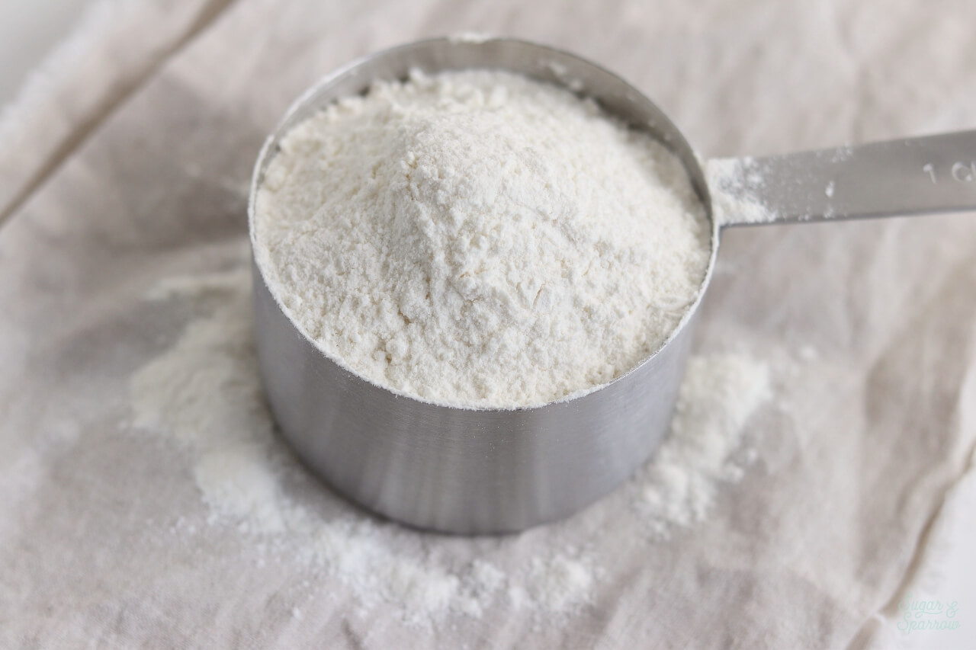
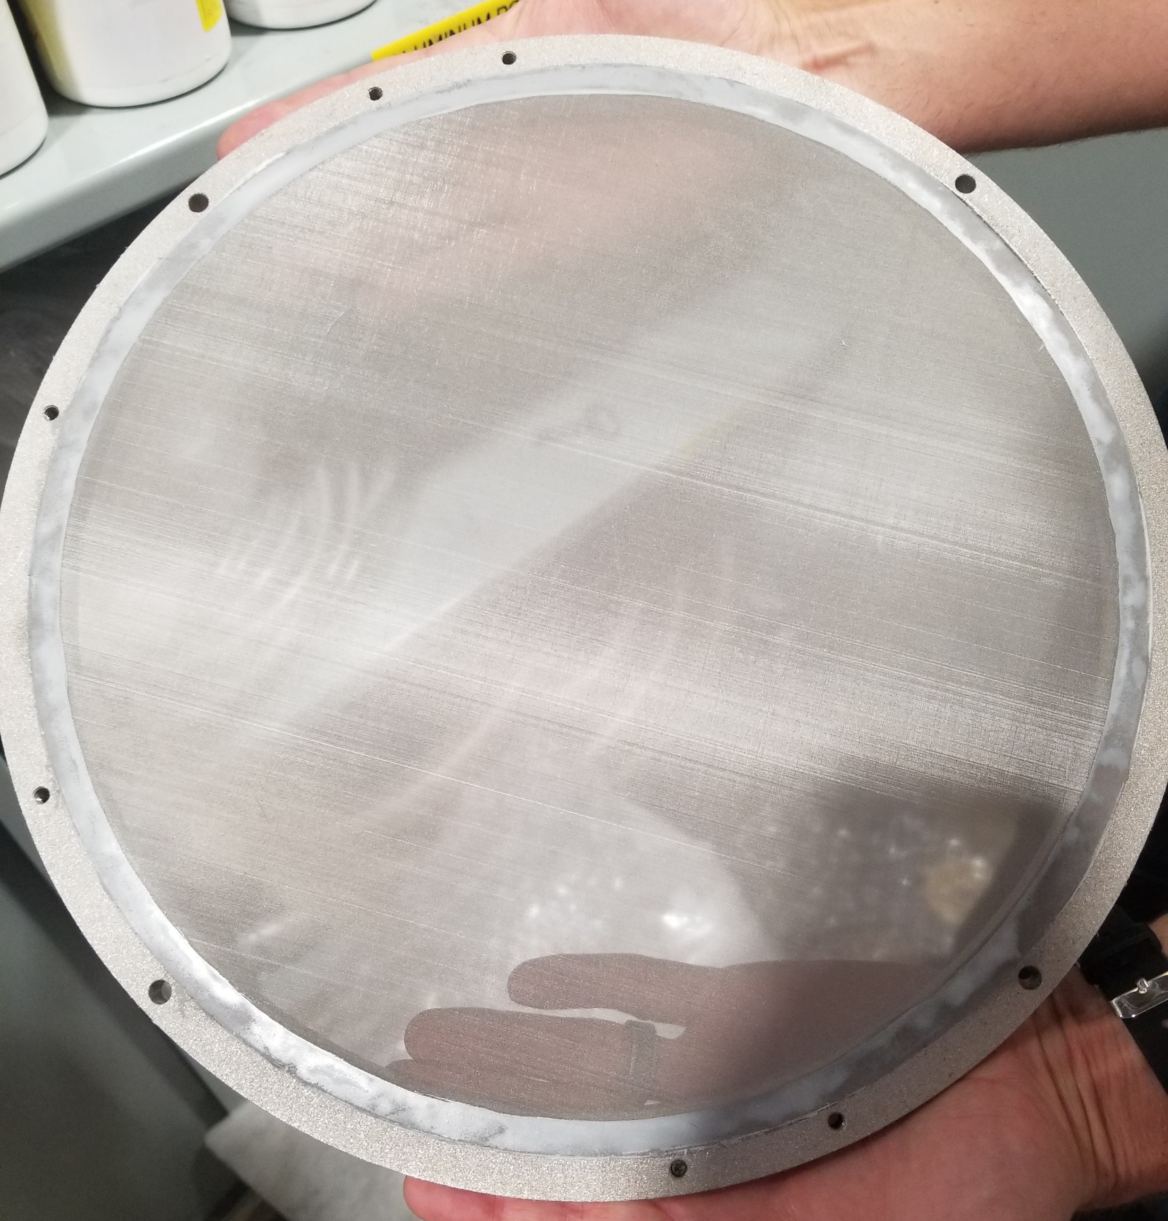
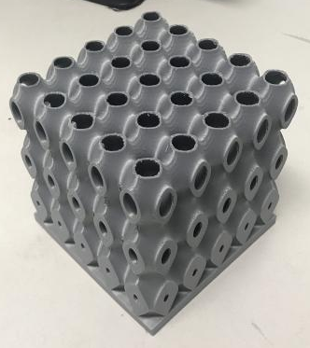
Validation
Flour: 25 – 400 μm
75 μm Mesh
Scaled 4x
Printed Test Parts
Arlan Ohrt

Slide 35
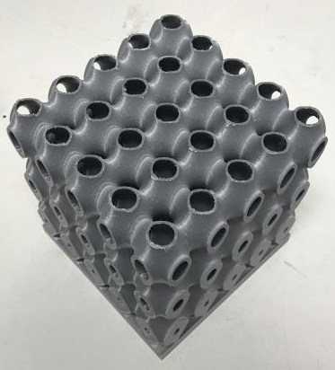
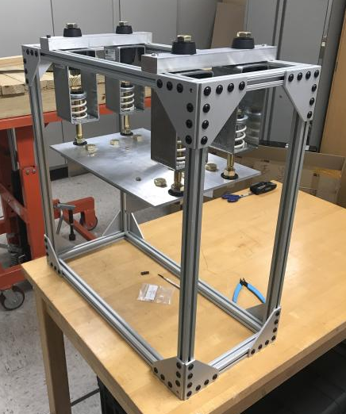
Validation
Scaled 4x
Printed Test Parts
Arlan Ohrt

Slide 36
Scaled 4x
Validation
Printed Test Parts
Arlan Ohrt

Slide 37
Budget
Enclosure
$2,000
$4,000
$6,000
$8,000
Design
$500
$1,000
$1,500
$2,000
Arlan Ohrt

Slide 38
Budget
Enclosure
$3,500
$2,000
$4,000
$6,000
$8,000
Design
$1,100
$500
$1,000
$1,500
$2,000
Arlan Ohrt

Slide 39
Design Budget
$1,100
$345
$292
$243
$220
$500
$1,000
$1,500
$2,000
Structure
Build Plate Holder
Pneumatics
Suspension
Arlan Ohrt

Slide 40
References
Title Slide Background - https://www.materialise.com/en/blog/when-how-and-where-of-metal-3d-printing
Recycle - https://www.recycling.com/wp-content/uploads/recycling%20symbols/black/Black%20Recycling%20Symbol%20%28U%2b267B%29.png
3D Systems – https://www.3dsystems.com/3d-printers/prox-dmp-300/specifications
LPBF Demo GIF - https://thescopepopculturescience.blogspot.com/2015_01_01_archive.html
Stainless Steel Properties - https://www.3dsystems.com/materials/metal
nTopology – https://ntopology.com/
PAPR – https://images-na.ssl-images-amazon.com/images/I/4125zPcBPNL.jpg
Sandblaster - https://badboyblasters.com/product/abrasive-media-sand-blaster-bb1050led-bvr-pr-hv-fl-2/
AFRL Sign - https://news.wfsu.org/post/eglin-air-force-base-ready-adjust-hiring-freeze
Electric Vibrator - https://www.mcmaster.com/5808k61
Dampeners - https://www.mcmaster.com/29895t54 , https://www.mcmaster.com/9241k44
Flour - https://sugarandsparrow.com/homemade-cake-flour-recipe/

Slide 41
Team 501: Powder Recovery for Metal Additive Manufacturing
Arlan Ohrt
Kevin Richter
Vincent Giannetti
Noah Tipton
Joshua Dorfman
March 10th, 2020

Slide 42
Backup Slides
3D Systems Printer Specs
Functional Decomposition
Precipitation Hardening Explained
Group Member Contact
17- 4PH Material
nTopology
Return

Slide 43
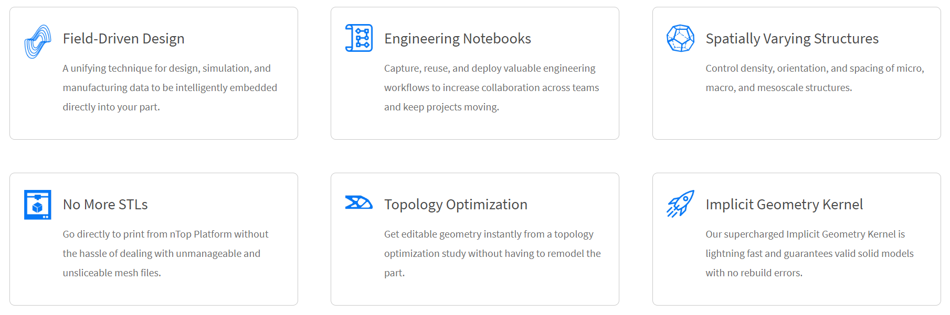
Return

Slide 44
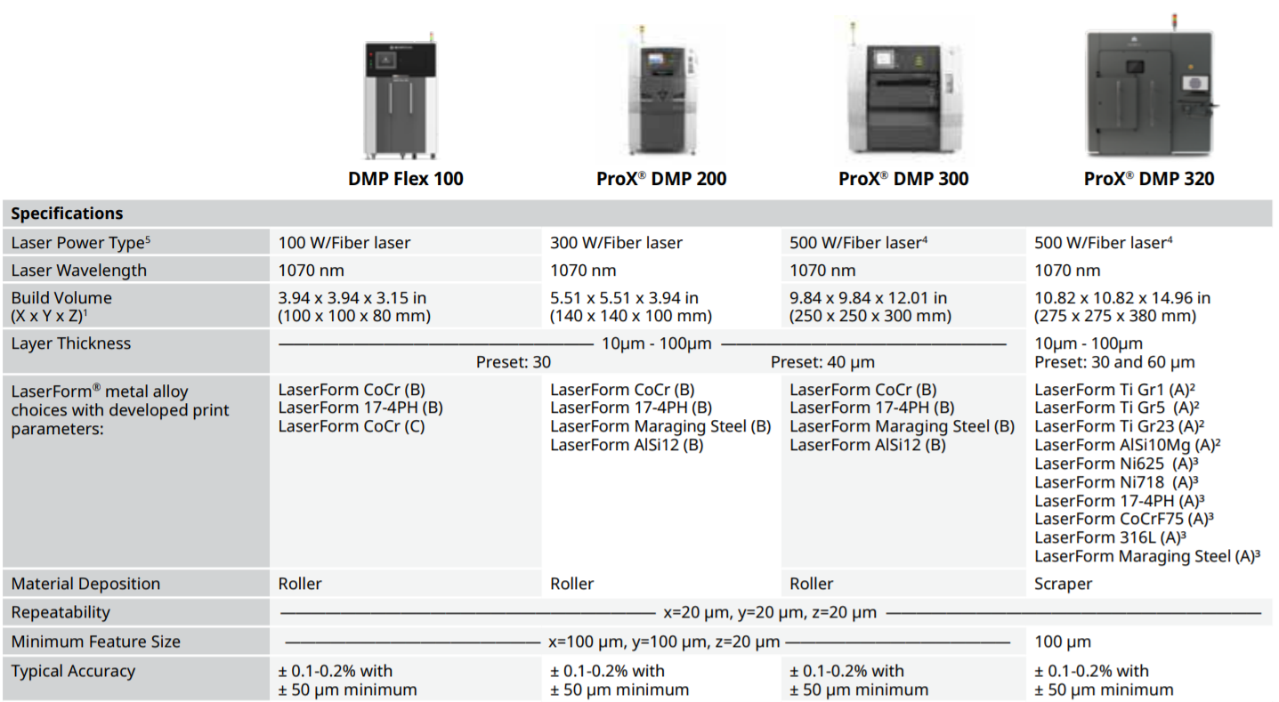
Return

Slide 45
Group Contact
Vincent Giannetti
Noah Tipton
Joshua Dorfman
Arlan Ohrt
Kevin Richter
vjg15b@my.fsu.edu
nrt15@my.fsu.edu
jd16s@my.fsu.edu
ago16b@my.fsu.edu
kr15@my.fsu.edu
Return

Slide 46
Functional Decomposition
Recover Powder
Manage Powder
Support the Part
Inhibit Powder
Separates powder from the part
Holds the part in the area
Insulates the user from powder
Transports powder to a container
Prevents powder contamination
Return

Slide 47
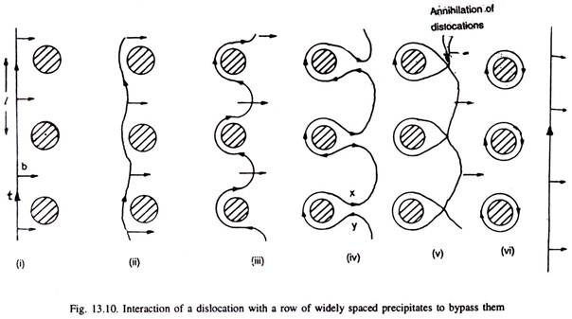
Precipitation Hardening Explained
The strength and hardness of some materials can be increased by the formation of very small particles
This is done through heat treatments
It is called “Precipitation Hardening” because the process results in very small particles, called “Precipitates”
This works because precipitates help block dislocation motion, which is an important aspect of a materials failure and properties
http://www.engineeringenotes.com/metallurgy/age-hardening-treatment/age-hardening-treatment-of-metals-metallurgy/26376
Return

Slide 48
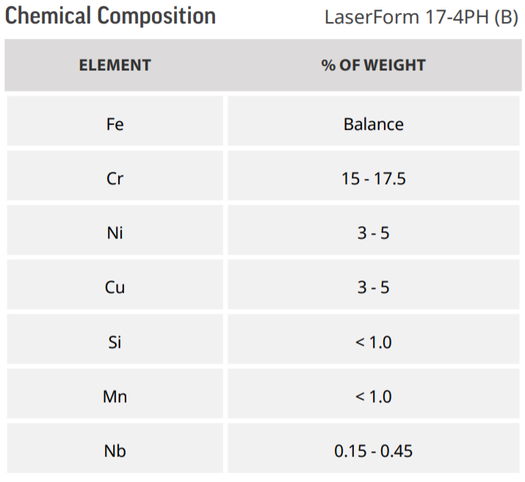
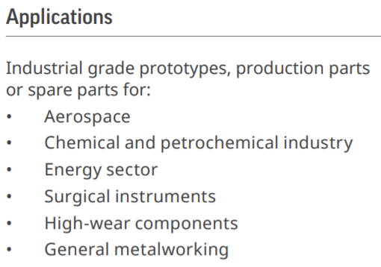
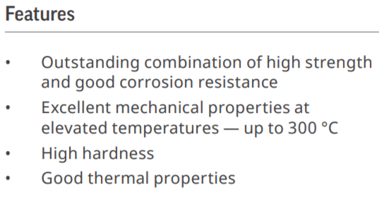
17- 4PH Stainless Steel
https://www.3dsystems.com/sites/default/files/2017-06/3D-Systems_17-4_PH_%28B%29_DMP_DATASHEET_US_A4_2017.06.21_WEB.pdf
Return

Slide 49
Arlan Ohrt

Slide 50
Standard Shapes
Summary Box
Text box 1
Outlined Text Box

Slide 51




Approved Logos

Slide 52
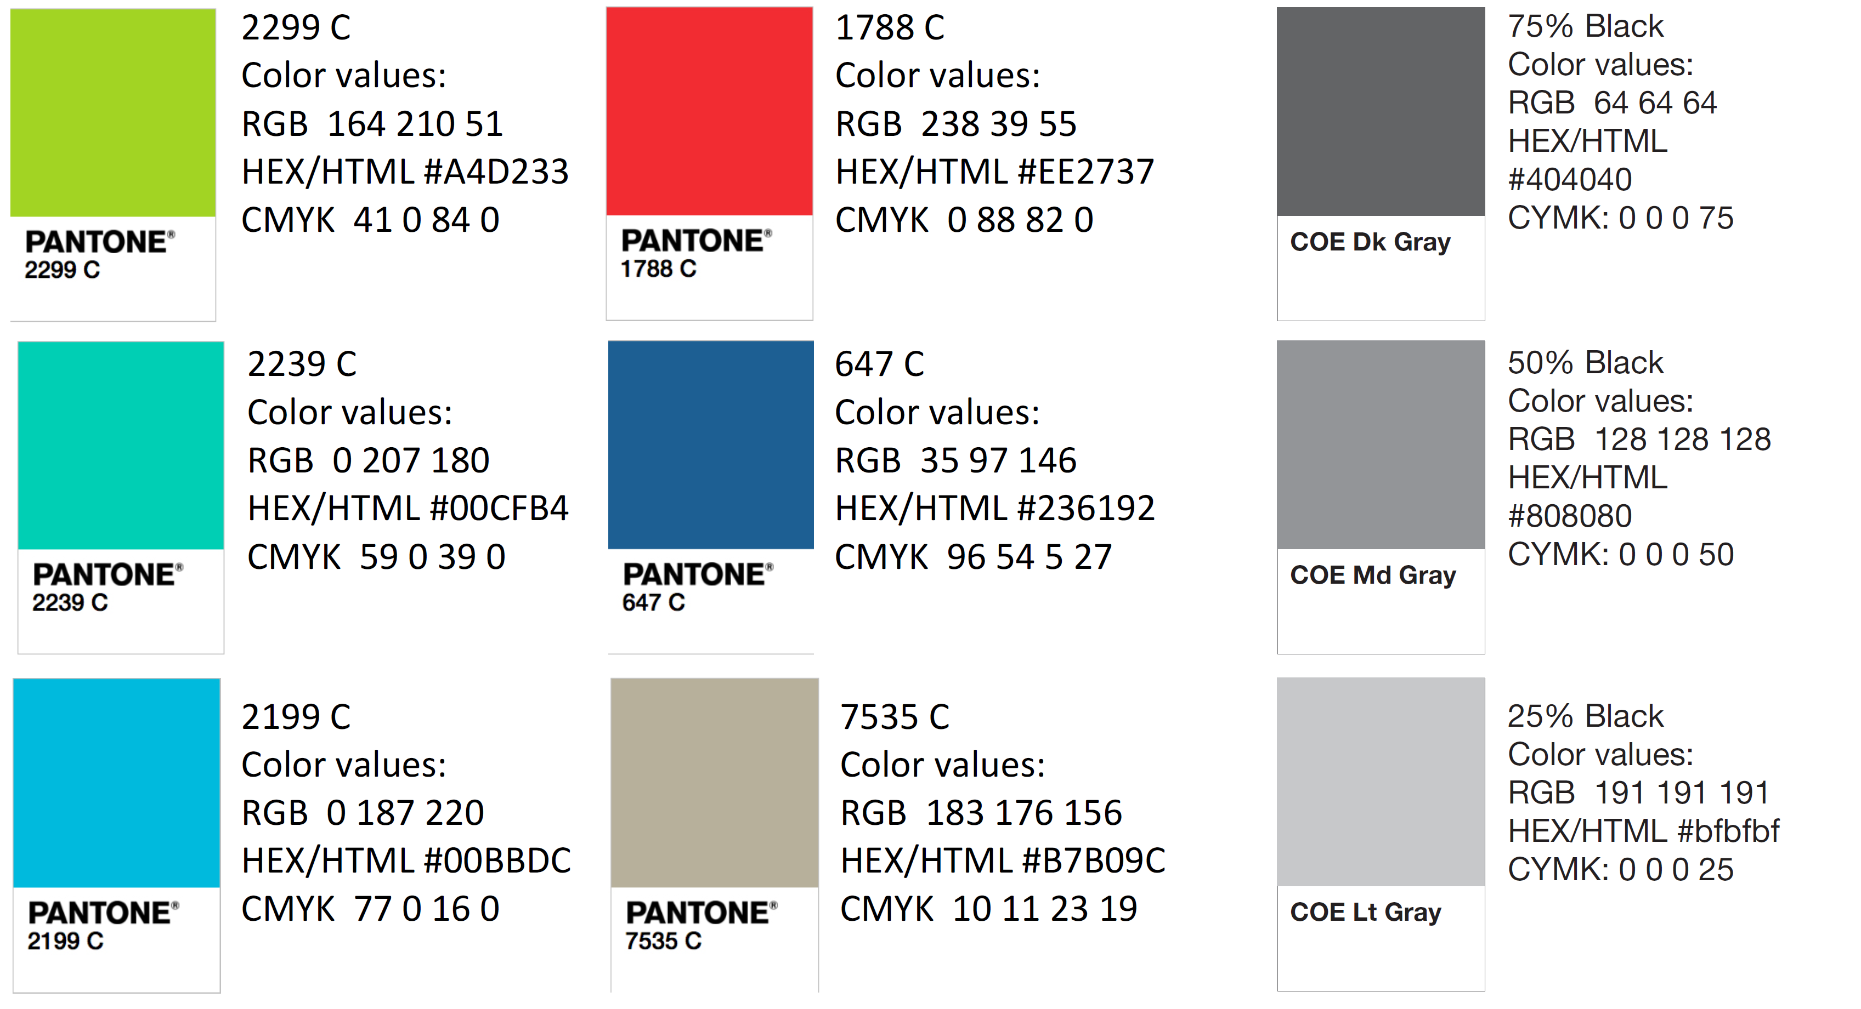
Color Palette

Slide 53
APA Tables
Category 1 | Category 2 | Category 3 | Category 4 | Category 5
Item 1
Item 2
Item 3
Item 4
 | Category 2 |  |  | Category 3
Category 1 | subcategory 1 | subcategory 2 |  | subcategory 1 | subcategory 2
Item 1
Item 2
Item 3
Item 4

